Slide 1
Veg Drone BY कृत्रिम-इंटेलिgence
Delhi Institute of Tool Engineering
mechatronics Engineering department

Slide 2
Delhi Institute of Tool Engineering (Guru Gobind Singh Indraprastha University)
Department of Mechatronics Engineering
Team Members:
कृत्रिम-इंटेलिgence Veg
Abhishek Tyagi (42370211217)
Sahil Kumar (41870211217)
Siddhant Jha (02970211217)
Yash Arora (03670211217)

Slide 3
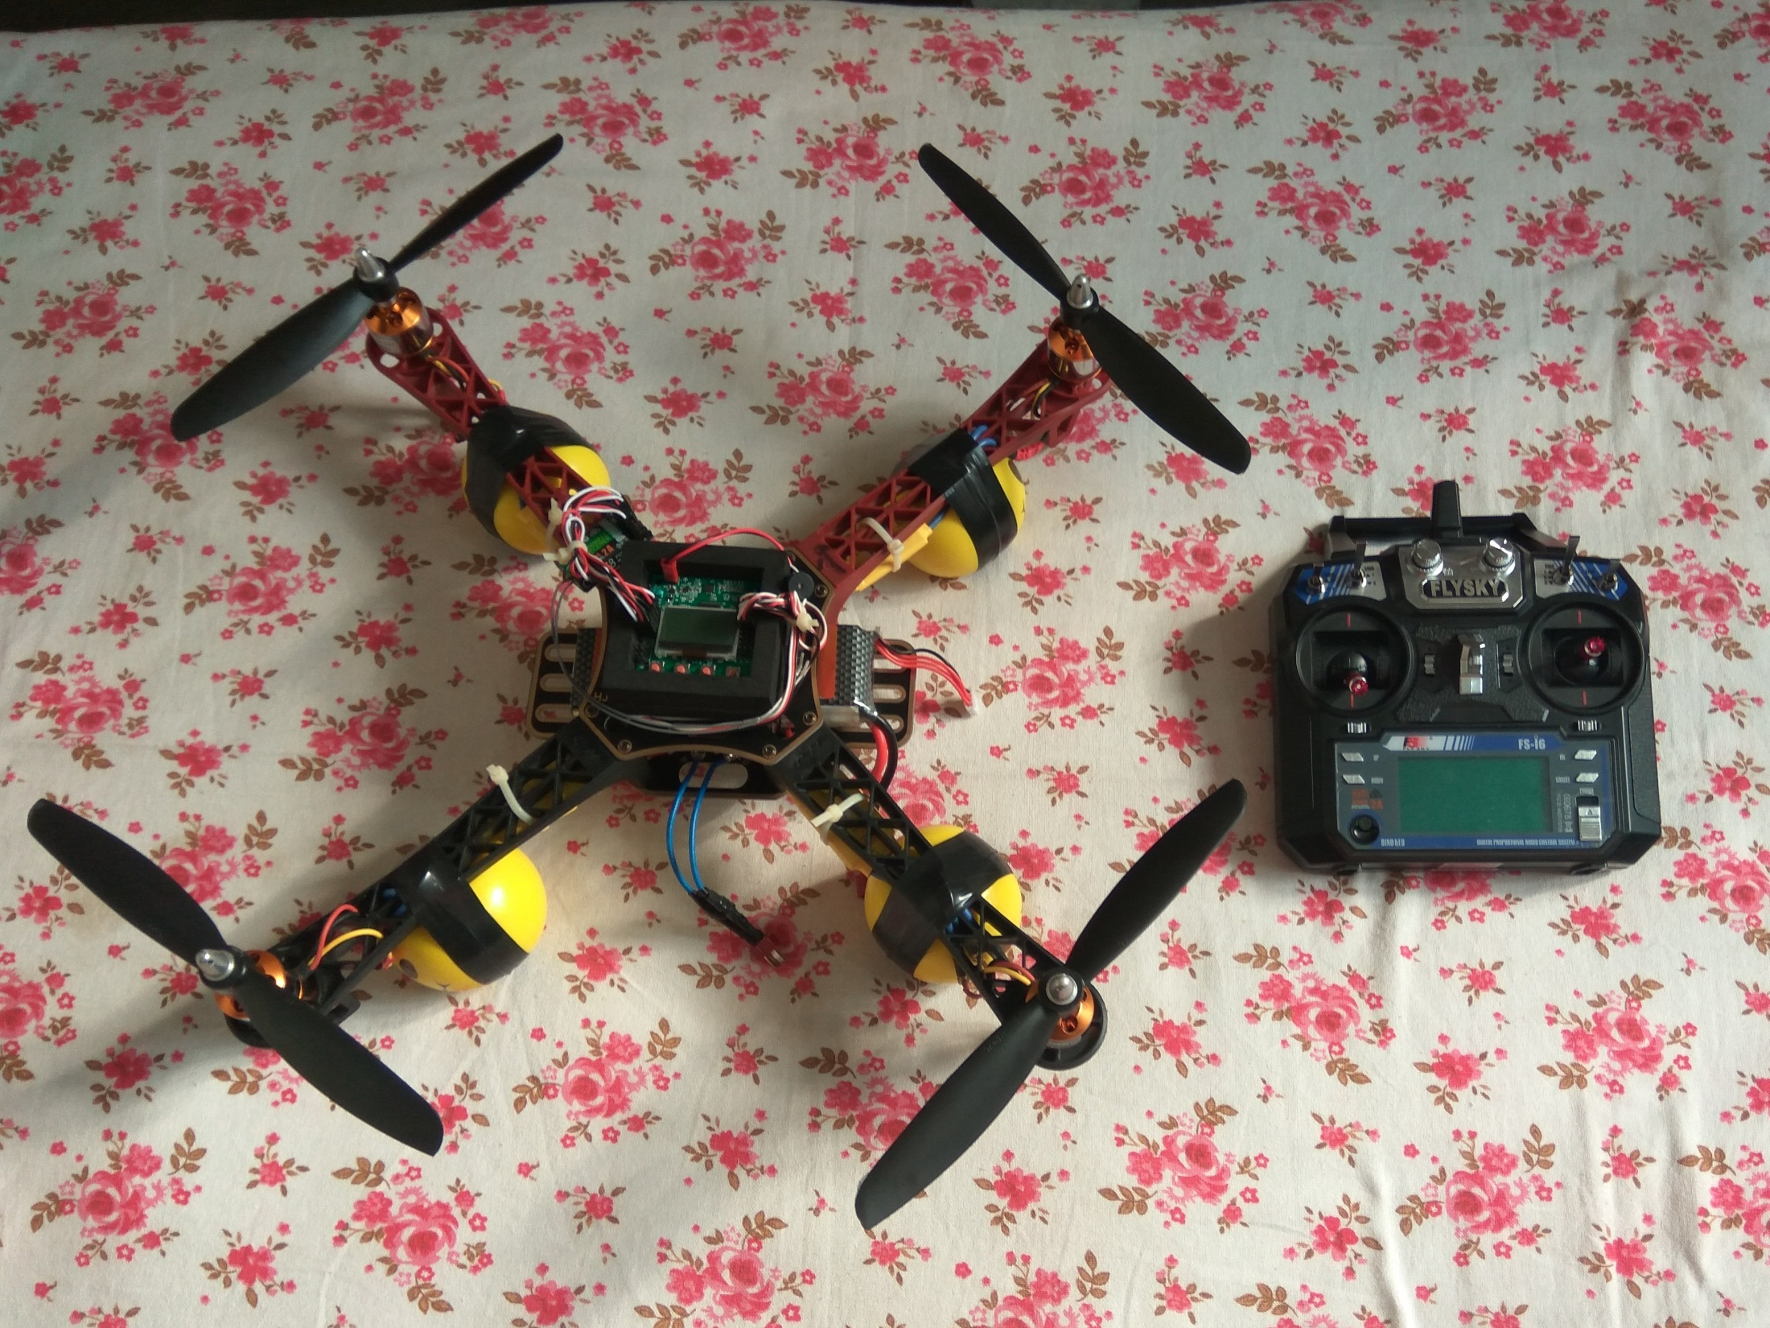
Veg under Development

Slide 4
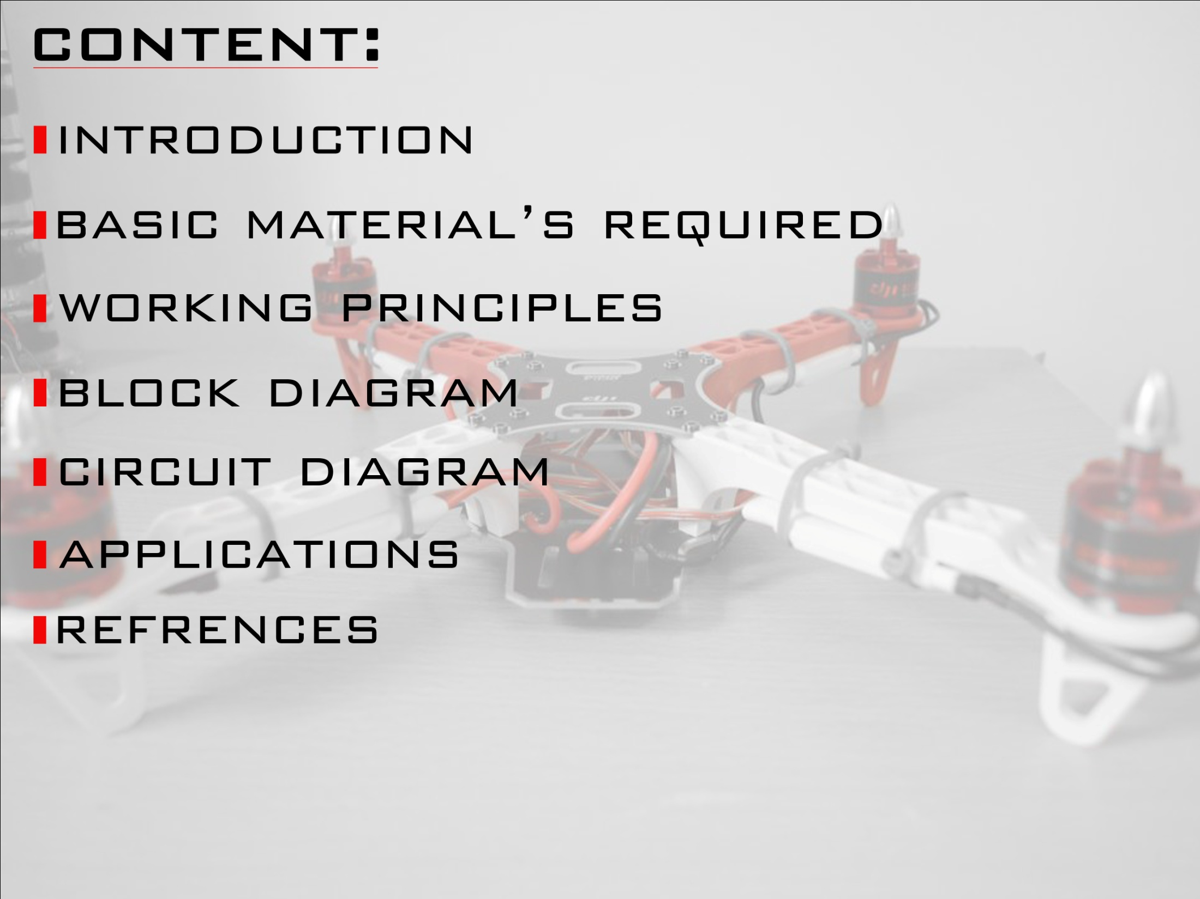

Slide 5
INTRODUCTION ( DRONE )
OVER THE LAST FEW YEARS WE HAVE SEEN A MASSIVE GROWTH IN THE MANUFACTURE AND SALES OF REMOTE CONTROL Airborne VEHICLES KNOWN AS QUADCOPTER.
THEY ARE SOME TIMES REFFERED TO AS DRONES, QUADROTERS OR QUAD COPTERS.
THESE UNMANNED AEREIL VEHICLES HAVE FOUR ARMS AND FIXED PITCH PROPELLERS WHICH ARE SET IN A 'X' OR + SYMBOL.
IN THE STANDARD FORMAT TWO PROPELERS WILL SPIN IN A CLOCK WISE DIRECTION WITH THE OTHER TWO SPINNING IN AN ANTI-CLOCK WISE DIRECTION ALLOWING TO FLY IN A DESIGNATED DIRECTION.

Slide 6
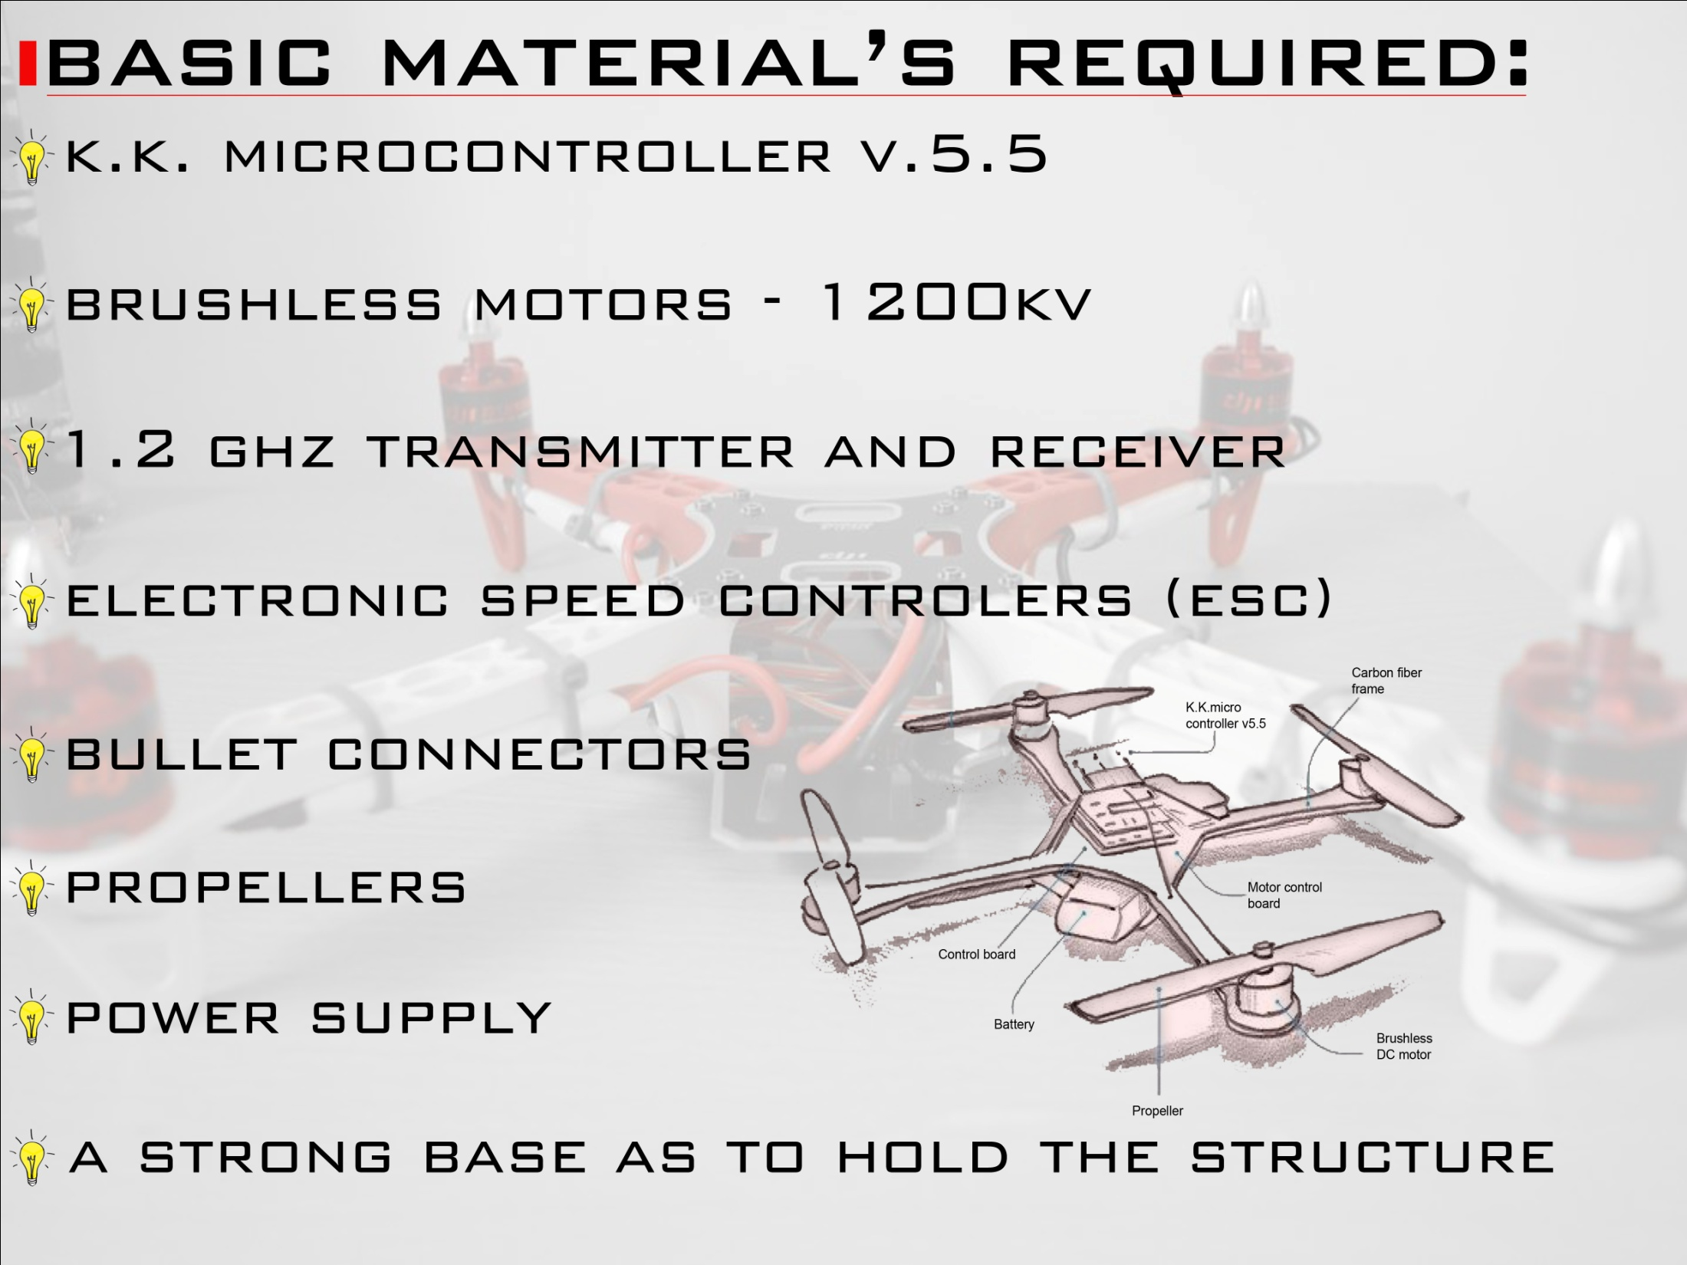

Slide 7
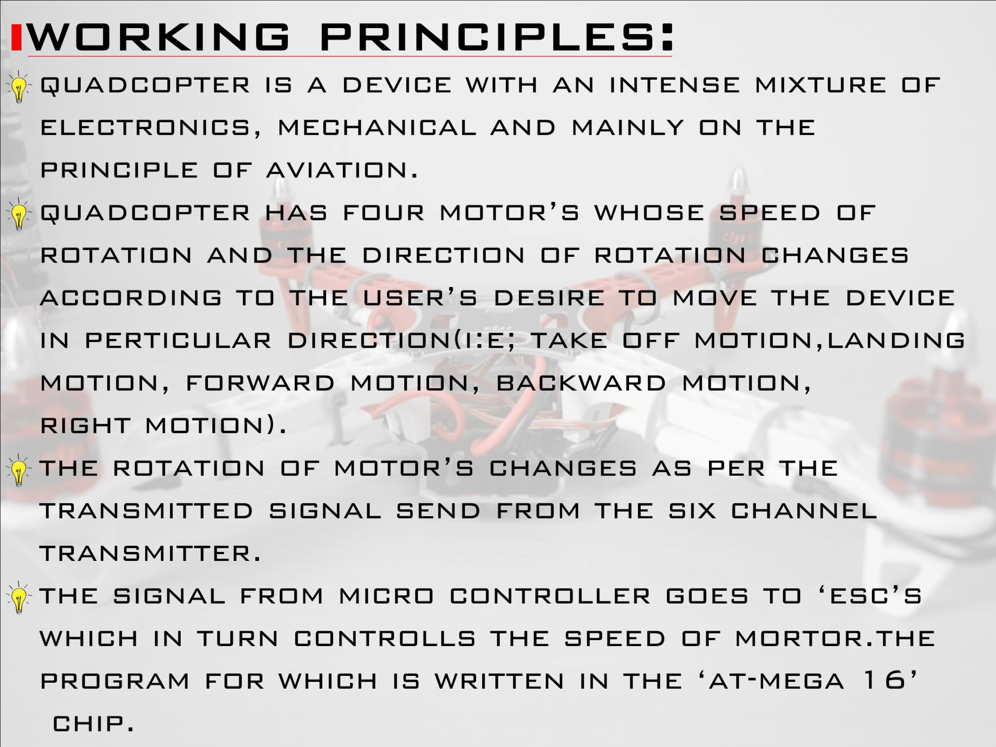

Slide 8
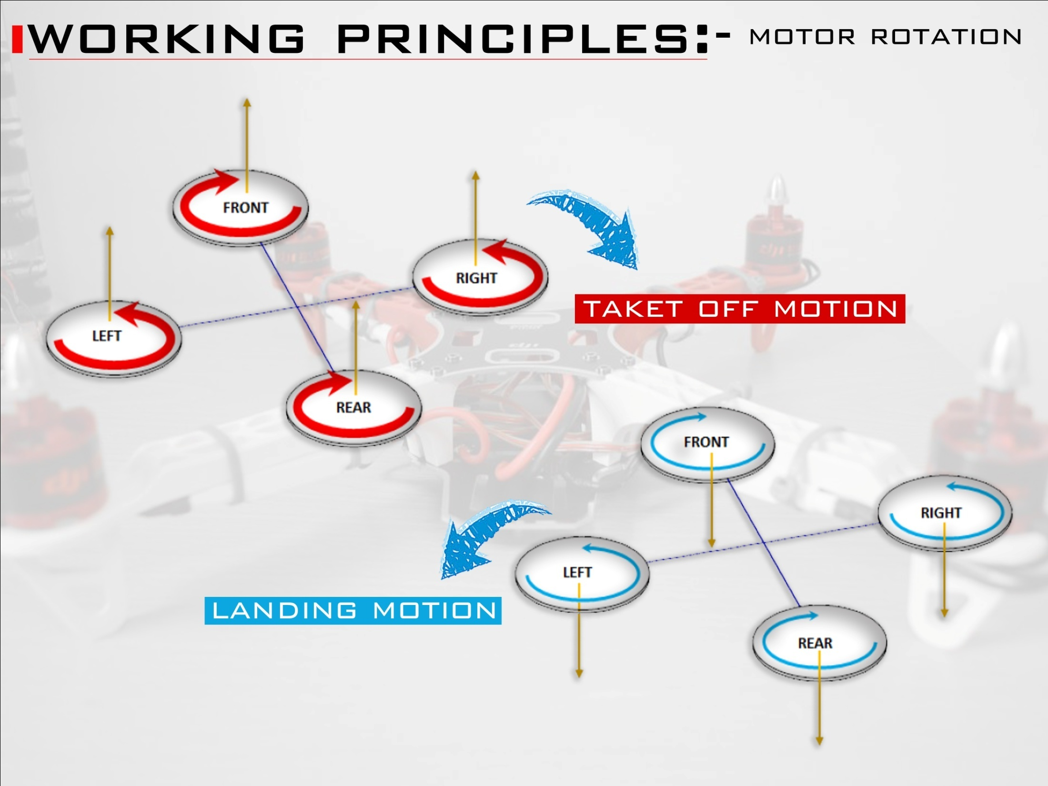

Slide 9
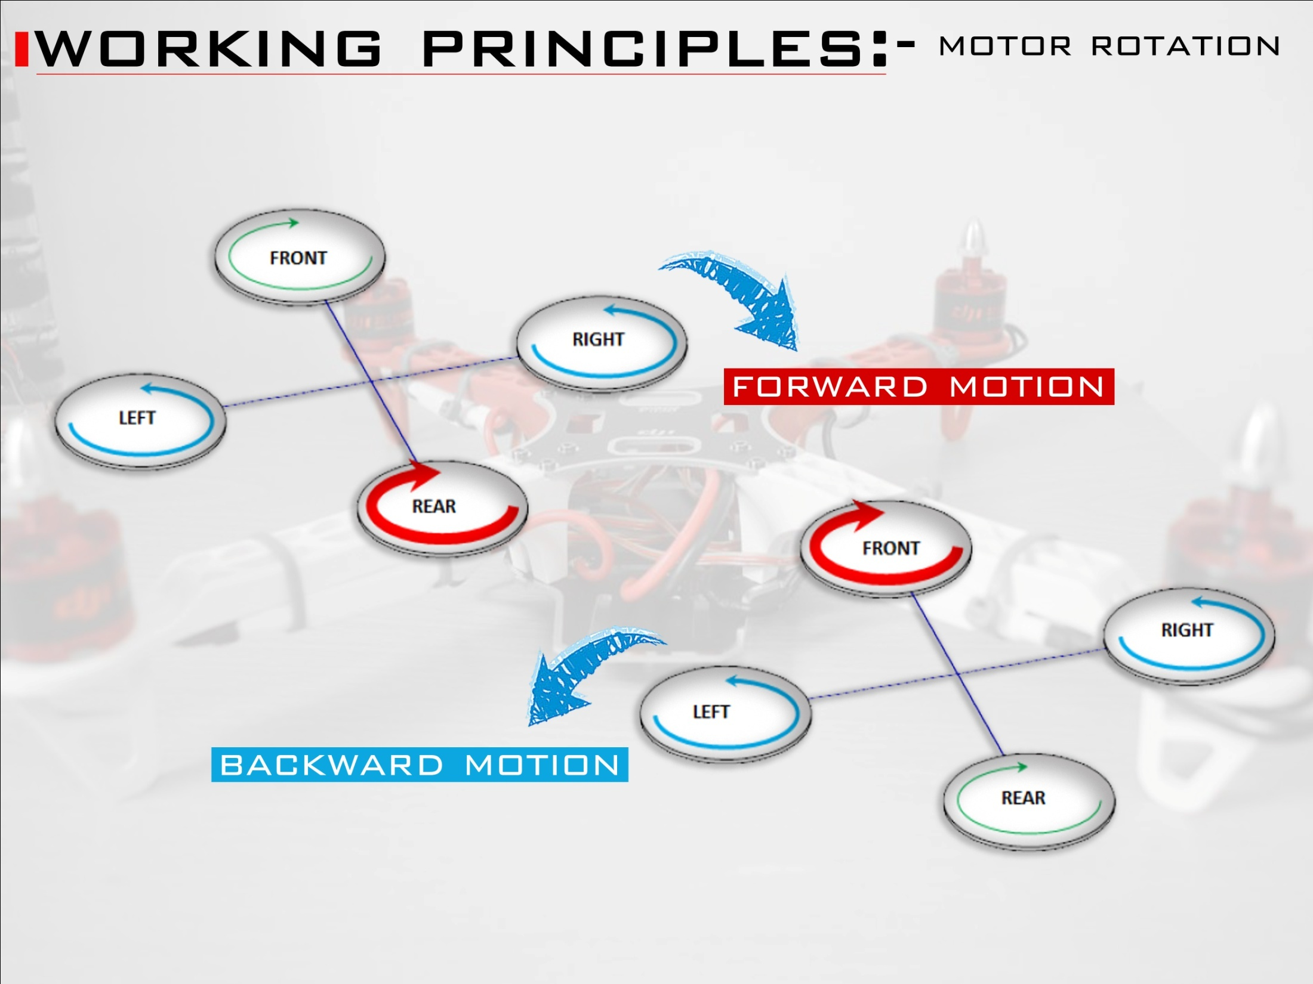

Slide 10
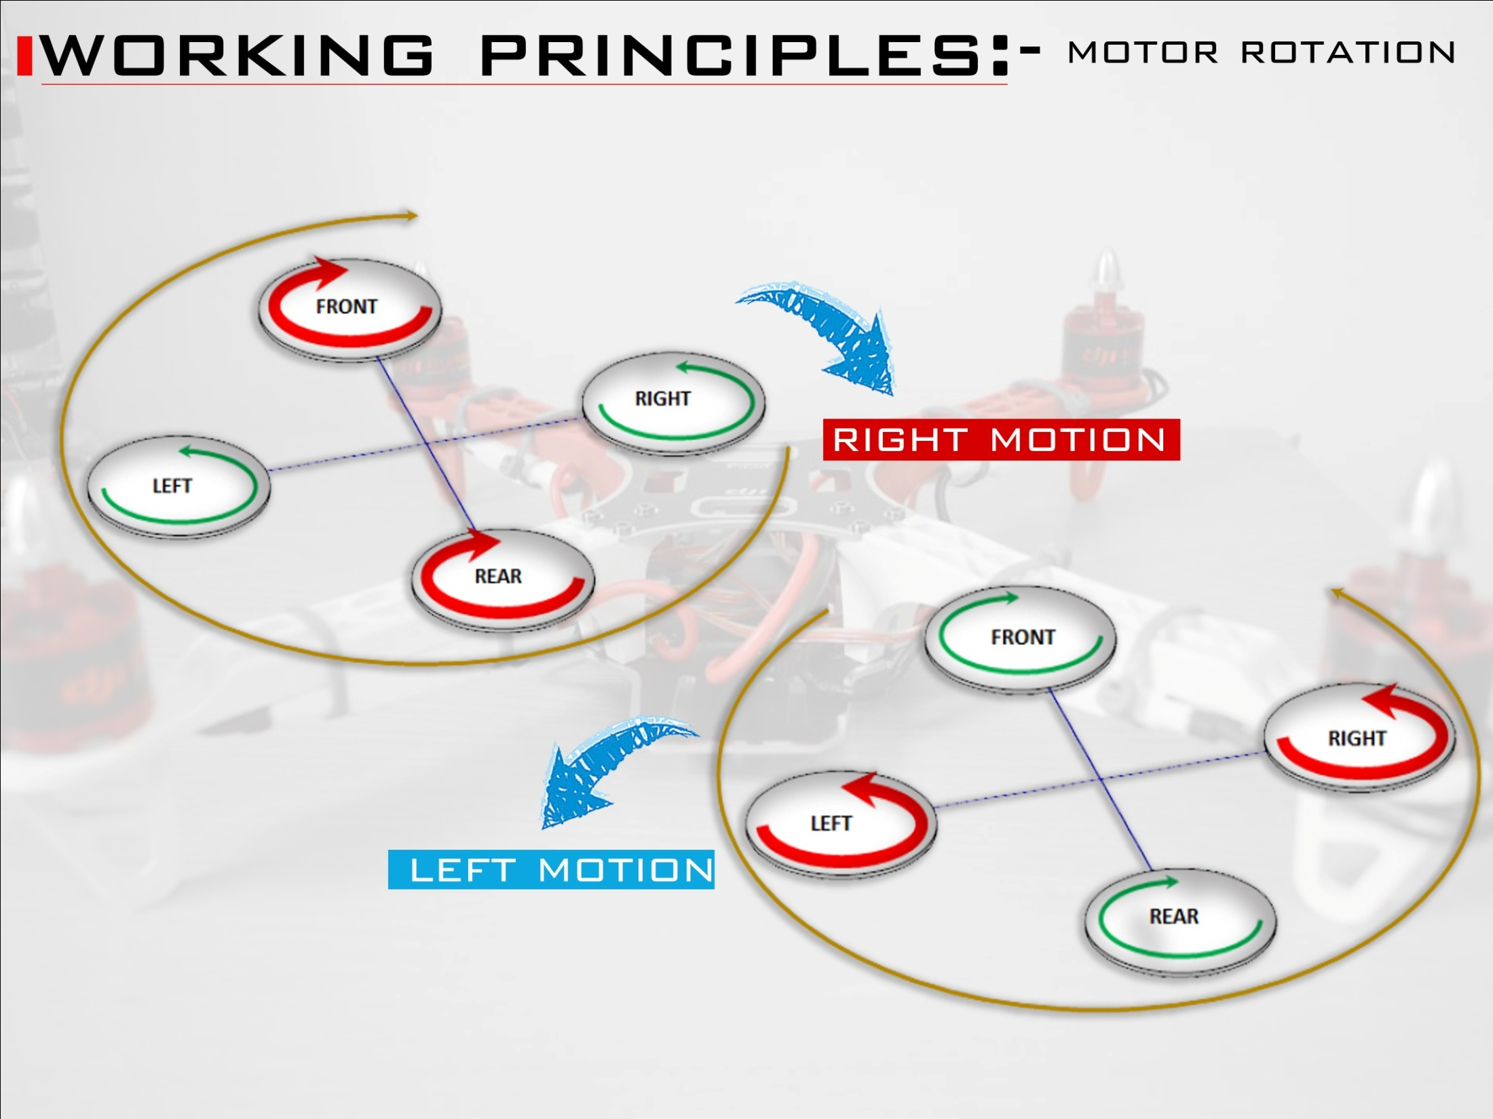

Slide 11
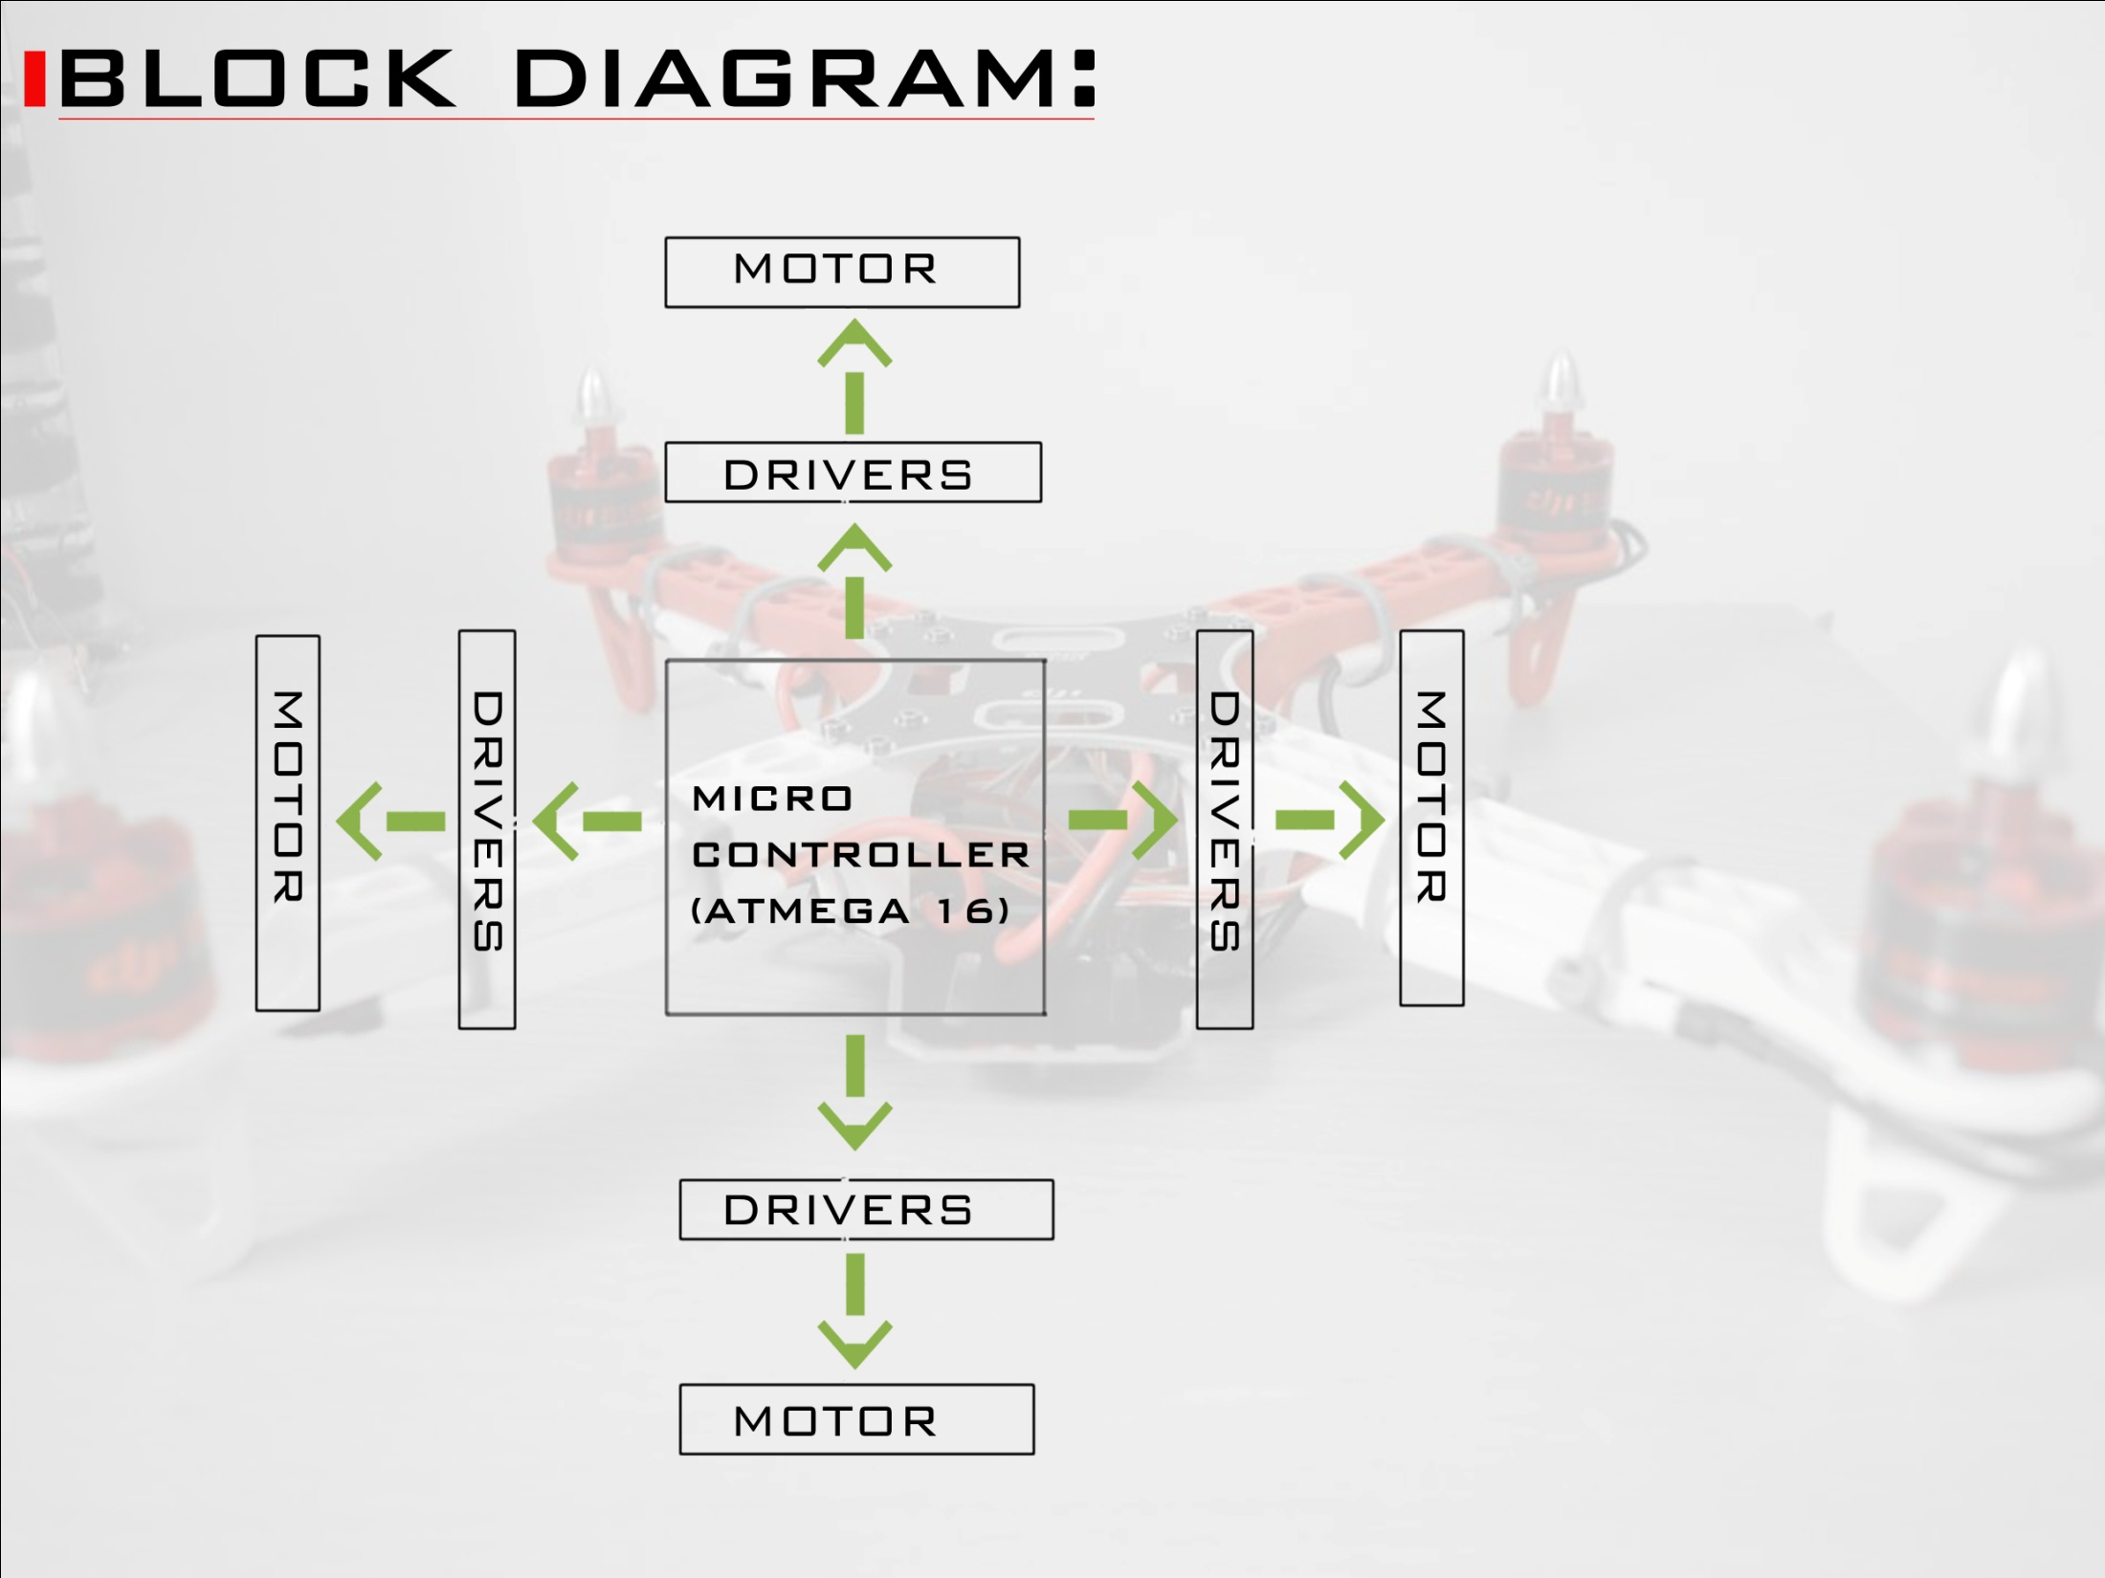

Slide 12
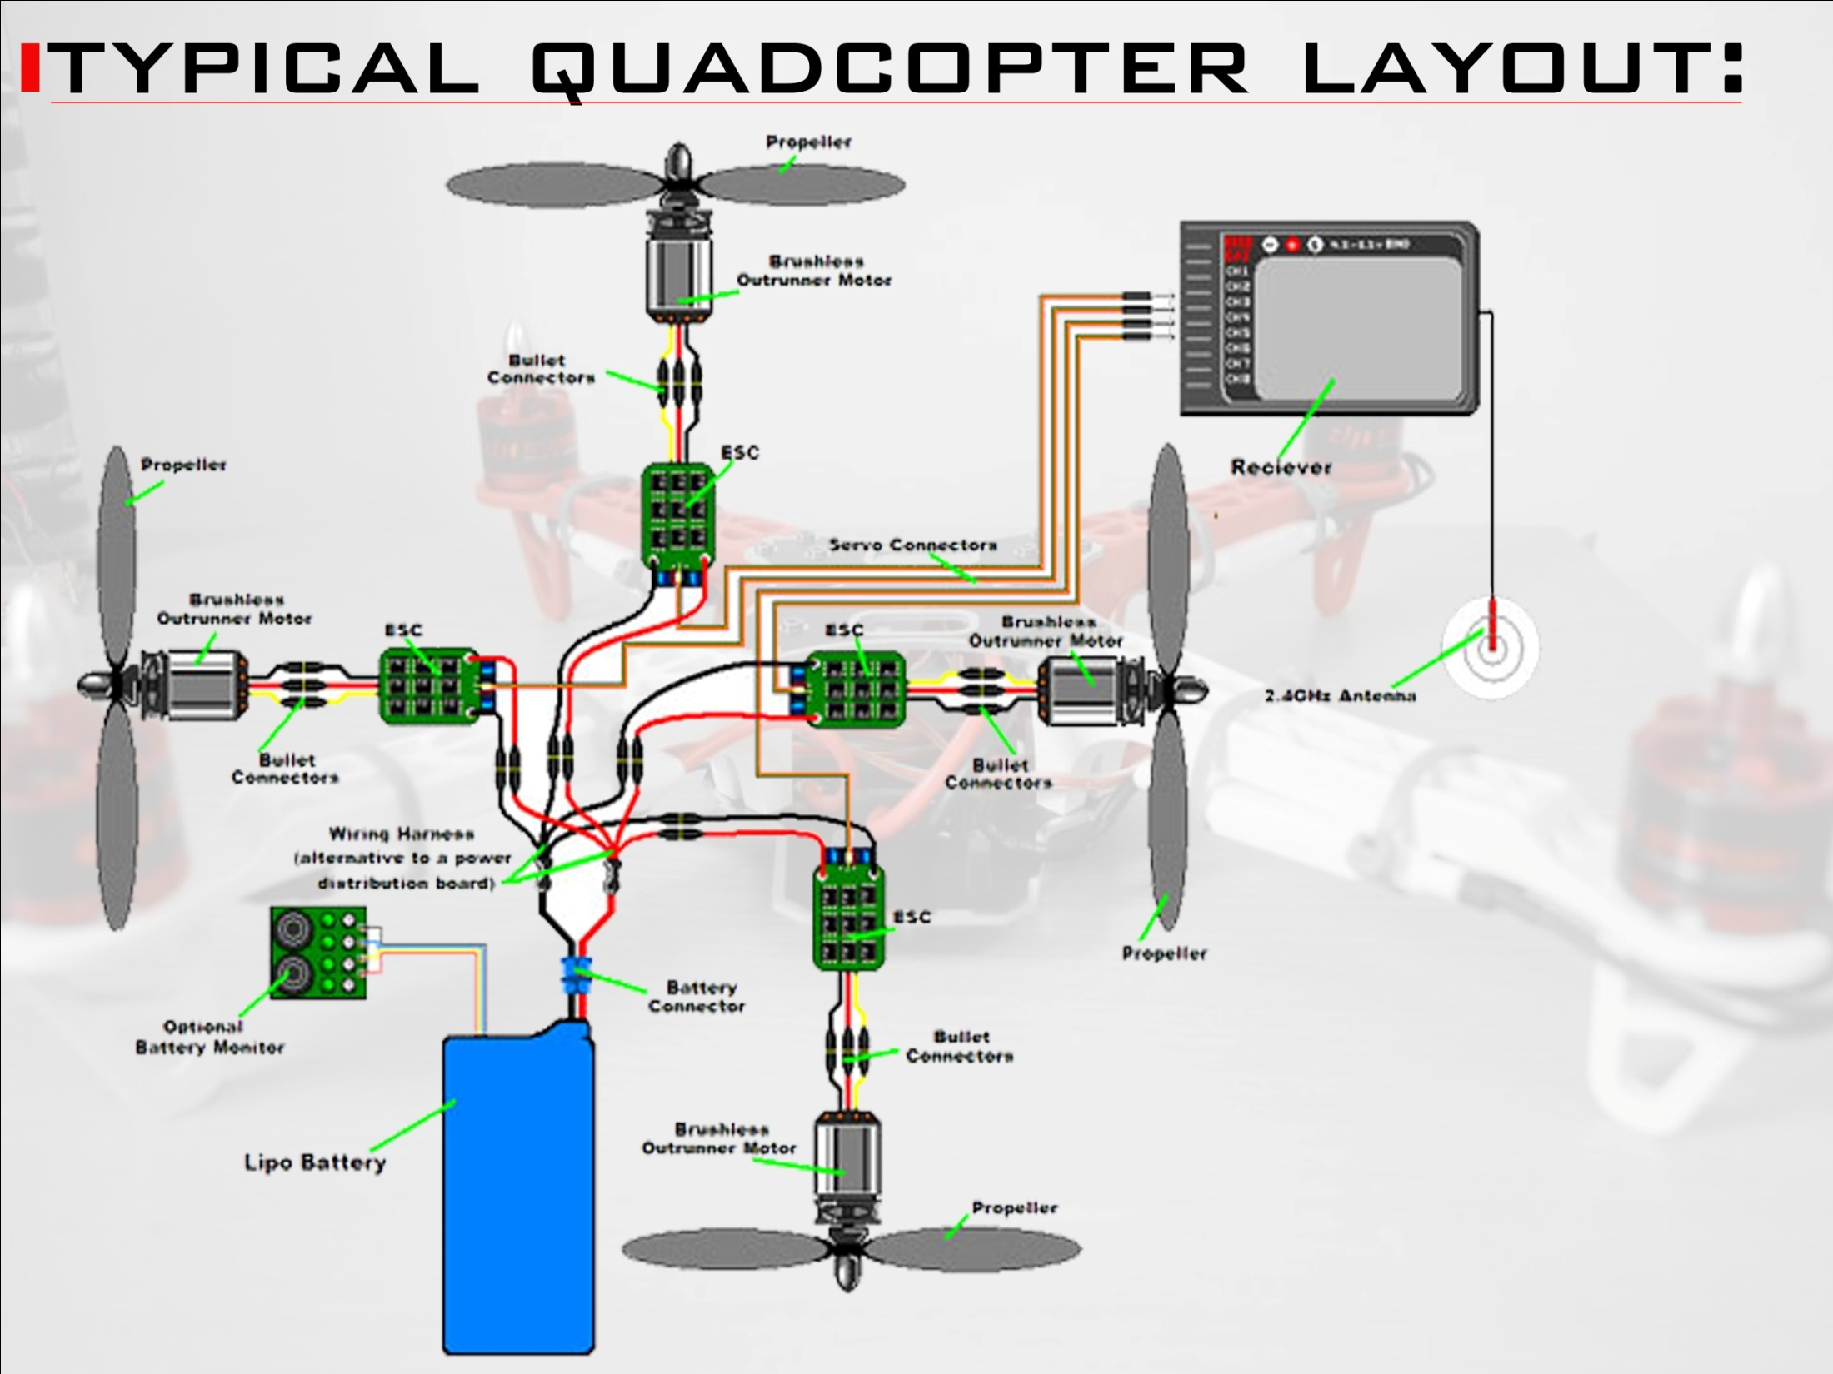

Slide 13
Surveillance Approaches and Challenges
Object Detection (Computer Vision / Deep Learning)
Face Recognition (Deep Learning)
Age and Gender Detection
SLAM Functioning ( R& D Approach )
LiDAR for Thermal Imaging

Slide 14
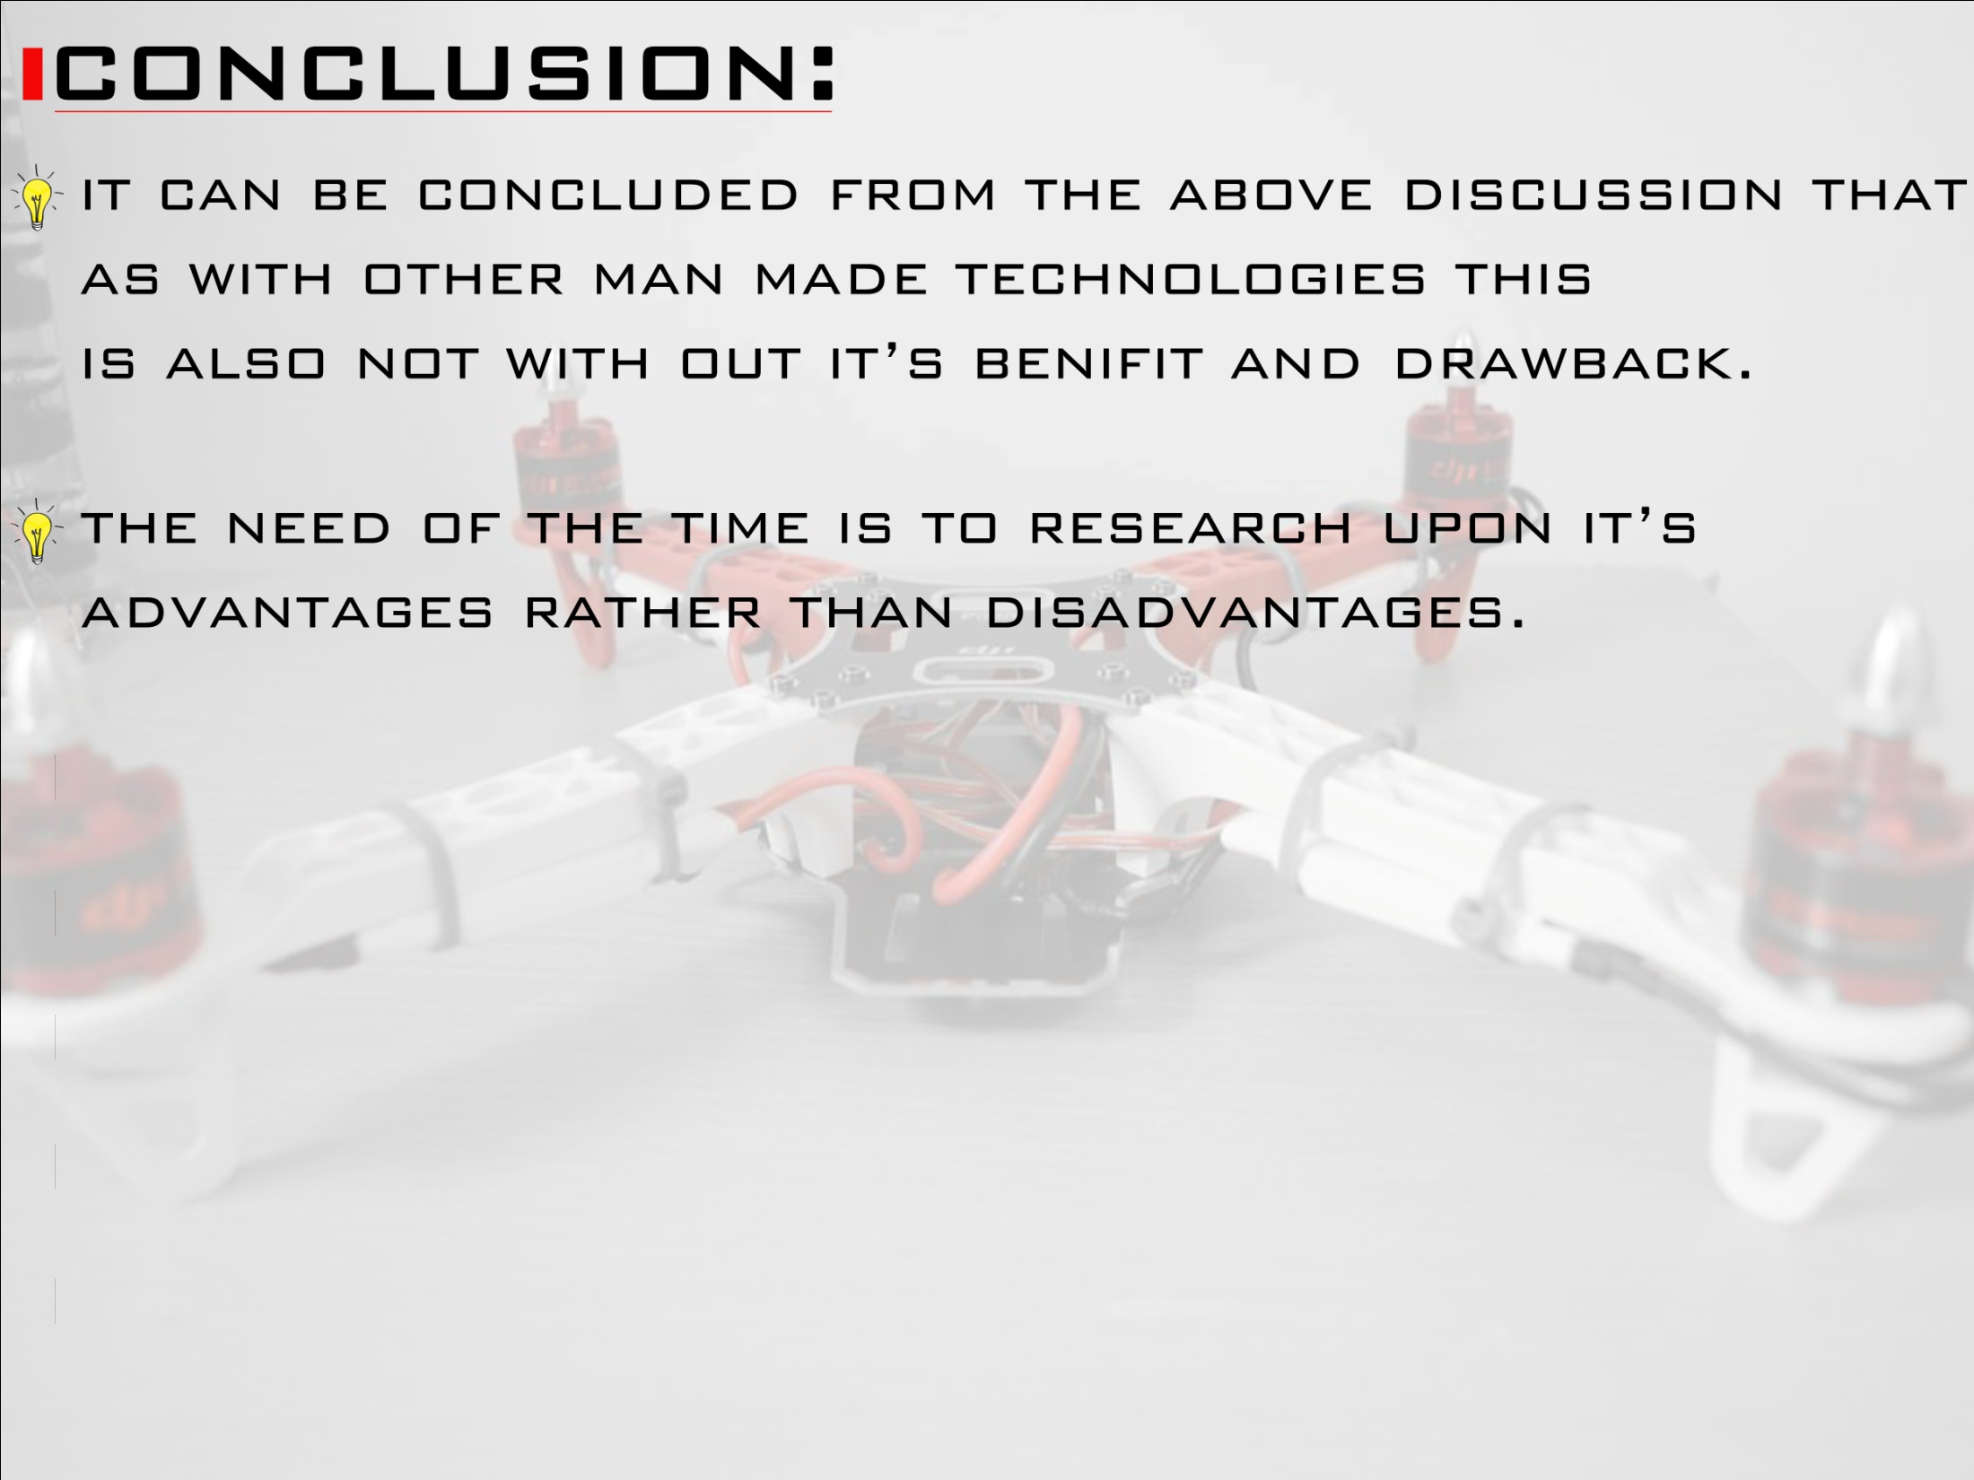

Slide 15


Slide 16
